Slide 1

Stochastic Modeling and Option Pricing
Institution
Stony Brook University
AMS 325: Applied Mathematics and Statistics
Comparative Analysis of Black-Scholes & Monte Carlo
Team Members:
Artemiy Polyanskiy
Lia Li
Tizian Henze
William Chan
Kyle Chan

Slide 2
Project Objective:
Pricing Options for Omnicom Group Inc. (OMC)
Primary Goal
Validation Method
Key Parameters
To model the stock price dynamics of Omnicom Group Inc. (OMC) and price European Call and Put options.
Comparing the analytical Black-Scholes model with the numerical Monte Carlo Simulation to prove convergence.
Stock: Omnicom Group Inc. (OMC)
Spot Price (S₀): $73.15
Strike Price (K): $65.00
Time to Maturity (T): 1 Year
Risk-Free Rate (r): 3.97%

Slide 3
Three-Step Methodology for Option Pricing
Calibration
Analytical Pricing
Numerical Validation
Estimate key parameters, primarily the Volatility (σ), from historical market data.
Calculate the exact theoretical option price using the Black-Scholes formula.
Approximate the option price using Monte Carlo Simulation (10,000 paths) to validate the analytical result.

Slide 4
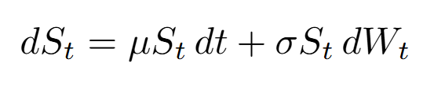
Modeling Stock Dynamics with Geometric Brownian Motion (GBM)
Equation:
Key Components:
Drift: μ
Represents the expected return of the stock, the deterministic trend component. In our case, we used the risk-free interest rate since our goal was to model option prices.
Volatility: σ
Represents the magnitude of price fluctuations and the "risk" of the stock.
Randomness: W_{t}
A Wiener process (Brownian motion) that introduces stochasticity into the model.

Slide 5
Data & Calibration: Estimating Volatility
Data Source
Parameter Estimation
Calibrated Volatility (σ)
Stock price data for OMC was retrieved using the yfinance library.
The critical parameter, Volatility (σ), was estimated from the last 252 days of historical closing prices.
31.77%
Estimated from 252-day historical closing price data of Omnicom Group Inc. (OMC)

Slide 6
Black-Scholes Model: The Analytical Solution
The Black-Scholes formula provides a closed-form, exact solution for pricing European options under the Geometric Brownian Motion assumption.
Analytical Results for OMC Options
$15.14
European Call
$10.15
European Put
Call Option Price
Put Option Price

Slide 7
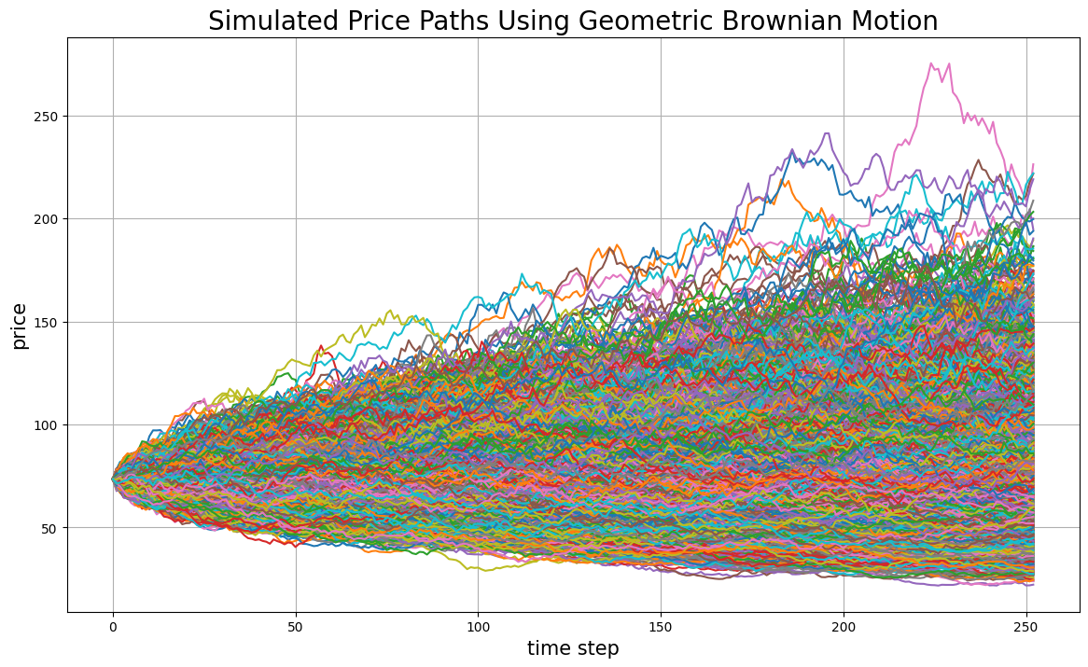
Monte Carlo Simulation: The Numerical Approximation
1)
2)
Simulate 10,000 independent stock price paths from S₀ to S_{T} using the discretized GBM equation.
Calculate the payoff for each path at maturity T: max(S_{T} − K, 0) for a Call option.
3)
4)
Discount the average payoff back to the present value using the risk-free rate r.
Average the payoffs across all 10,000 paths to obtain the expected payoff.

Slide 8
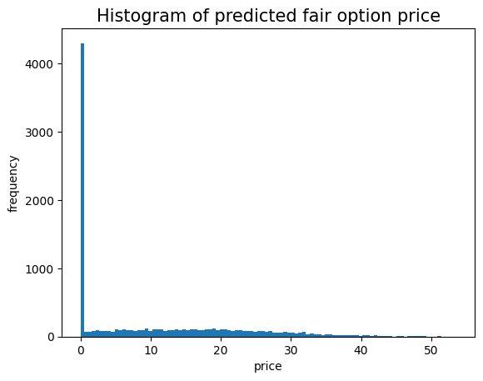
Option Price Distribution
This is the final distribution of predicted fair option prices from the Monte Carlo simulation. The formula we used to convert the predicted stock prices to fair option prices is:
For a call,
max(S_{T} − K, 0) * discount factor
For a put,
max(K - S_{T}, 0) * discount factor
where,
discount factor = e^{(-r * T)}

Slide 9
Validation: Convergence of Numerical and Analytical Results
Option Type | Black-Scholes (Analytical) | Monte Carlo (Numerical) | Difference (Error)
Call Option | $15.14 | $14.95 | $0.19
Put Option | $10.15 | $10.23 | $0.08
Key Findings:
Convergence Achieved: The Monte Carlo simulation results are extremely close to the Black-Scholes prices, demonstrating the convergence of the numerical method.
Error Analysis: The small differences (≤ 1.3%) are expected due to the nature of Monte Carlo approximation (sampling error).

Slide 10
Conclusion: A Robust and Validated Model
The project successfully demonstrated a comprehensive comparative analysis of two fundamental option pricing techniques, yielding highly consistent and reliable results.
Key Takeaways:
Model Validity:
The Geometric Brownian Motion model successfully captured the stock price dynamics of OMC.
Methodology Success:
The Monte Carlo Simulation validated the analytical Black-Scholes results, confirming robustness.
Key Driver:
Volatility (σ = 31.77%) remains the most influential and sensitive parameter in option pricing.
The convergence of numerical and analytical methods demonstrates the reliability of our pricing framework for practical applications.

